Slide 1
The Open Systems Interconnection Model (OSI Model)

Slide 2
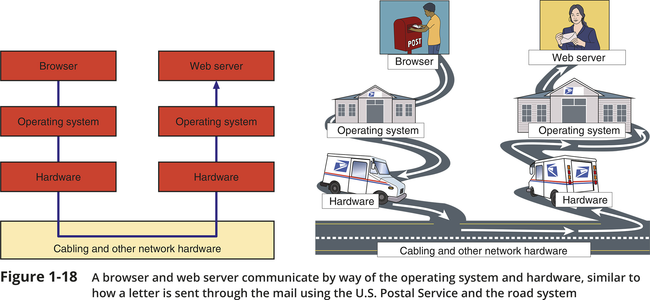
The Seven-Layer OSI Model (1 of 2)

Slide 3
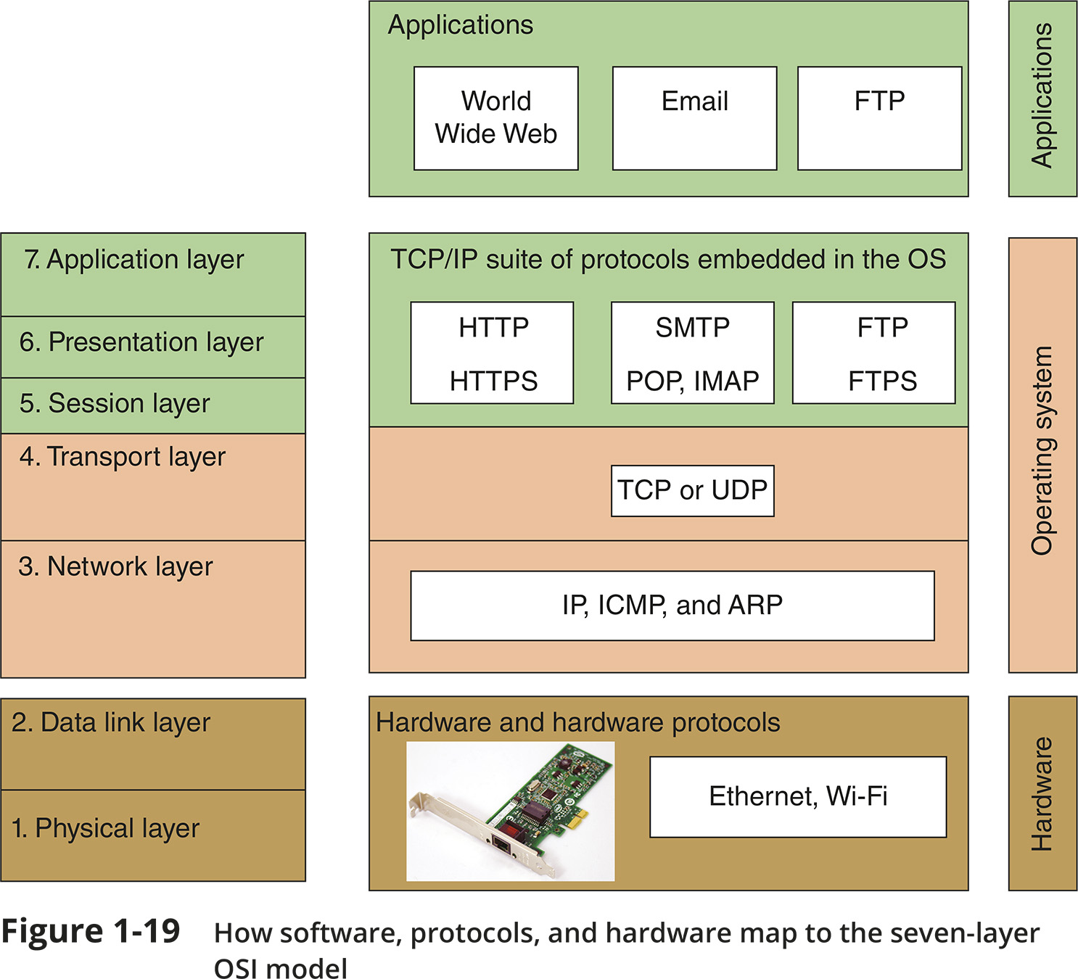
The Seven-Layer OSI Model (2 of 2)

Slide 4
Layer 7: Application Layer
The application layer describes the interface between two applications, on separate computers
Application layer protocols are used by programs that fall into two categories:
Provide services to a user, such as a browser and Web server
Utility programs that provide services to the system, such as SNMP (Simple Network Management Protocol) programs that monitor and gather information about network traffic
Payload is the data that is passed between applications or utility programs and the OS

Slide 5
Layer 6: Presentation Layer
The presentation layer is responsible for reformatting, compressing, and/or encrypting data in a way that the receiving application can read
Example:
An email message can be encrypted at the Presentation layer by the email client or by the OS

Slide 6
Layer 5: Session Layer
The session layer describes how data between applications is synched and recovered if messages don’t arrive intact at the receiving application
The application, presentation, and session layers are intertwined
It is often difficult to distinguish between them
Most tasks are performed by the OS when an application makes an API call to the OS
An API (application programming interface) call is the method an application uses when it makes a request of the OS

Slide 7
Layer 4: Transport Layer
The transport layer is responsible for transporting Application layer payloads from one application to another
Two main Transport layer protocols are:
TCP (Transmission Control Protocol) - makes a connection with the end host, checks whether data was received; called a connection-oriented protocol
UDP (User Datagram Protocol) - does not guarantee delivery by first connecting and checking whether data is received; called a connectionless protocol

Slide 8
Layer 4: Transport Layer
Protocols add control information in an area at the beginning of the payload (called header)
Encapsulation is the process of adding a header to the data inherited from the layer above
The Transport layer header addresses the receiving application by a number called a port
If a message is too large, TCP divides it into smaller messages called segments
In UDP, the message is called a datagram

Slide 9
Layer 3: Network Layer
The network layer is responsible for moving messages from one node to another until they reach the destination host
The principal protocol used by this layer is IP (Internet Protocol)
IP adds its own network layer header to the segment or datagram
The entire network layer message is called a packet

Slide 10
Layer 3: Network Layer
An IP address is an address assigned to each node on a network
The network layer uses it to uniquely identify each host
IP relies on several routing protocols to find the best route for a packet to take to reach destination
ICMP and ARP are examples
Network layer protocol will divide large packets into smaller packets in a process called fragmentation

Slide 11
Layer 2: Data Link Layer
Layers 2 and 1 are responsible for interfacing with physical hardware on the local network
Protocols at these layers are programmed into firmware of a computer’s NIC and other hardware
Type of networking hardware or technology used on a network determine the data link layer protocol used
Ethernet and Wi-Fi are examples

Slide 12
Layer 2: Data Link Layer
The data link layer puts control information in a data link layer header and at the end of the packet in a trailer
The entire data link layer message is called a frame
A MAC (Media Access Control) address is also called a physical address, hardware address, or data link layer address
It is embedded on every network adapter

Slide 13
Layer 1: Physical Layer
The physical layer is responsible for sending bits via a wired or wireless transmission
Bits can be transmitted as:
Wavelengths in the air
Voltage on a copper wire
Light (via fibre-optic cabling)

Slide 14
Protocol Data Unit or PDU
Protocol data unit (PDU) is the technical name for a group of bits as it moves from one layer to the next and from one LAN to the next
Technicians loosely call this group of bits a message or a transmission

Slide 15
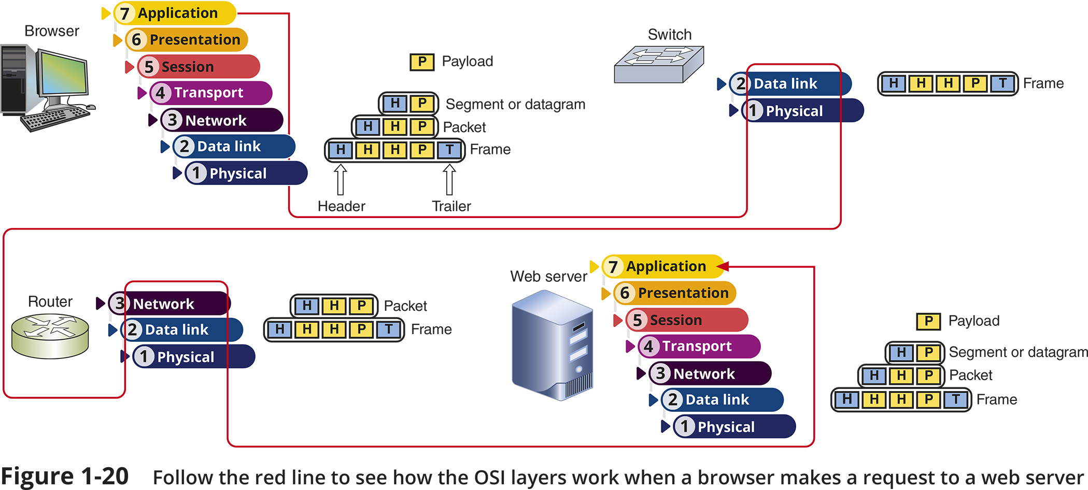
Summary of How the Layers Work Together

